Slide 1

Object Oriented Programming with C++ Project
Employee Payroll System
Presented by
U. Deepika (25B11AIC25)
B. Sri Chandana (25B11AI129)
Y. Renuka Lahari (25B11AIC88)
Ch. Sahithi (25B11AI210)
Department of Artificial Intelligence & Machine Learning

Slide 2




Presentation Outline
Abstract
Introduction
Problem Statement
Objectives
Proposed System
System Flowchart
C++ concepts used
System Modules
Sample Output
Conclusion

Slide 3
Abstract
The Employee Payroll System is a C++ based application developed to manage employee
salary details efficiently.
It stores basic employee information such as employee ID, name, and salary.
It calculates gross salary, deductions, and net salary.
The system reduces manual calculations and minimizes errors.
It provides a simple menu-driven interface for performing payroll operations.
The project demonstrates the practical use of C++ programming concepts.

Slide 4
Introduction
Payroll management is an important task in every organization for maintaining
employee salary information.
Manual payroll processing requires more time and effort.
Repeated calculations may result in errors.
The proposed system automates basic salary calculations.
Employees can be added and their payroll details can be displayed.
The system is implemented using C++ as a console-based application.

Slide 5
Problem Statement
Managing employee salary details manually can be difficult and time-consuming.
Manual calculations may lead to incorrect salary results.
Maintaining employee records manually is less efficient.
Calculating allowances and deductions repeatedly requires additional effort.
It can be difficult to quickly retrieve an employee's salary information.
Problem:
To develop a simple C++ application that manages employee information and performs
payroll calculations accurately and efficiently.

Slide 6
Objectives
The main objectives of the Employee Payroll System are:
To maintain basic employee information.
To calculate employee salary automatically.
To calculate gross salary and net salary.
To reduce manual calculation and errors.
To provide a simple and user-friendly menu-driven system.
To demonstrate the use of C++ programming concepts in a real-world
application.

Slide 7
Proposed System
The proposed system is a menu-driven C++ application for managing employee
payroll.
Main Features:
Add employee details.
Enter basic salary.
Calculate allowances and deductions.
Calculate gross salary.
Calculate net salary.
Display employee payroll details.
Exit the application.
Salary Calculation:
Gross Salary = Basic Salary + Allowances
Net Salary = Gross Salary − Deductions

Slide 8
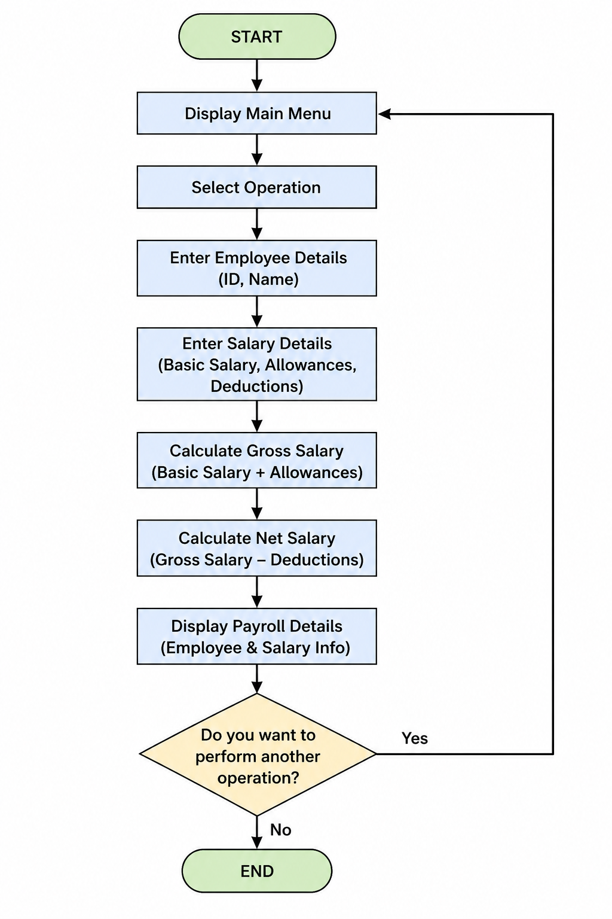
System Flowchart

Slide 9
C++ Concepts used
The following C++ concepts are used in the project:
Classes and Objects – Used to represent employee information.
Functions – Used to perform salary calculations and display details.
Variables and Data Types – Used to store employee and salary information.
Conditional Statements – Used for decision-making.
Loops – Used to repeatedly display and process menu options.
Input/Output – cin and cout are used for user interaction.
Menu-Driven Programming – Allows the user to select different operations.

Slide 10
System Modules
The Employee Payroll System consists of the following modules:
Employee Details Module
Accepts employee ID and name.
Stores employee information.
2. Salary Input Module
Accepts basic salary.
Accepts allowances and deductions.
3. Payroll Calculation Module
Calculates gross salary.
Calculates net salary.
4. Display Module
Displays employee details.
Displays complete salary information.
5. Menu Module
Provides options to the user.
Controls the overall execution of the program.

Slide 11
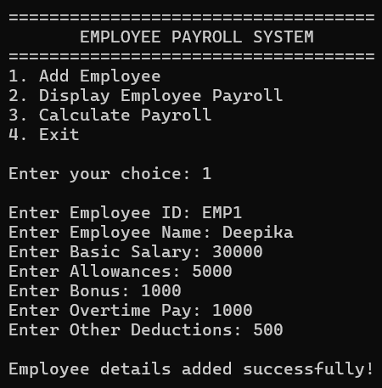
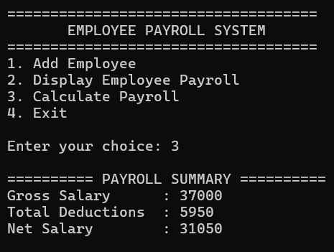
Output

Slide 12
Conclusion
The Employee Payroll System successfully demonstrates how C++ can be used
to solve a real-world payroll management problem.
It simplifies employee salary calculations.
It reduces manual effort and calculation errors.
The menu-driven approach makes the system easy to operate.
The project demonstrates important C++ concepts such as classes, functions,
conditions, and loops.
The system can be enhanced in the future by adding file handling, database
connectivity, search/update/delete options, and a graphical user interface.

Slide 13
THANK YOU

